Slide 1
Intro to CS
Week 4
16/2

Slide 2
What is Computer Science
Computer science is the study of algorithms, including:
Their formal and mathematical properties
Their linguistic realizations
Their hardware realizations
Their applications

Slide 3
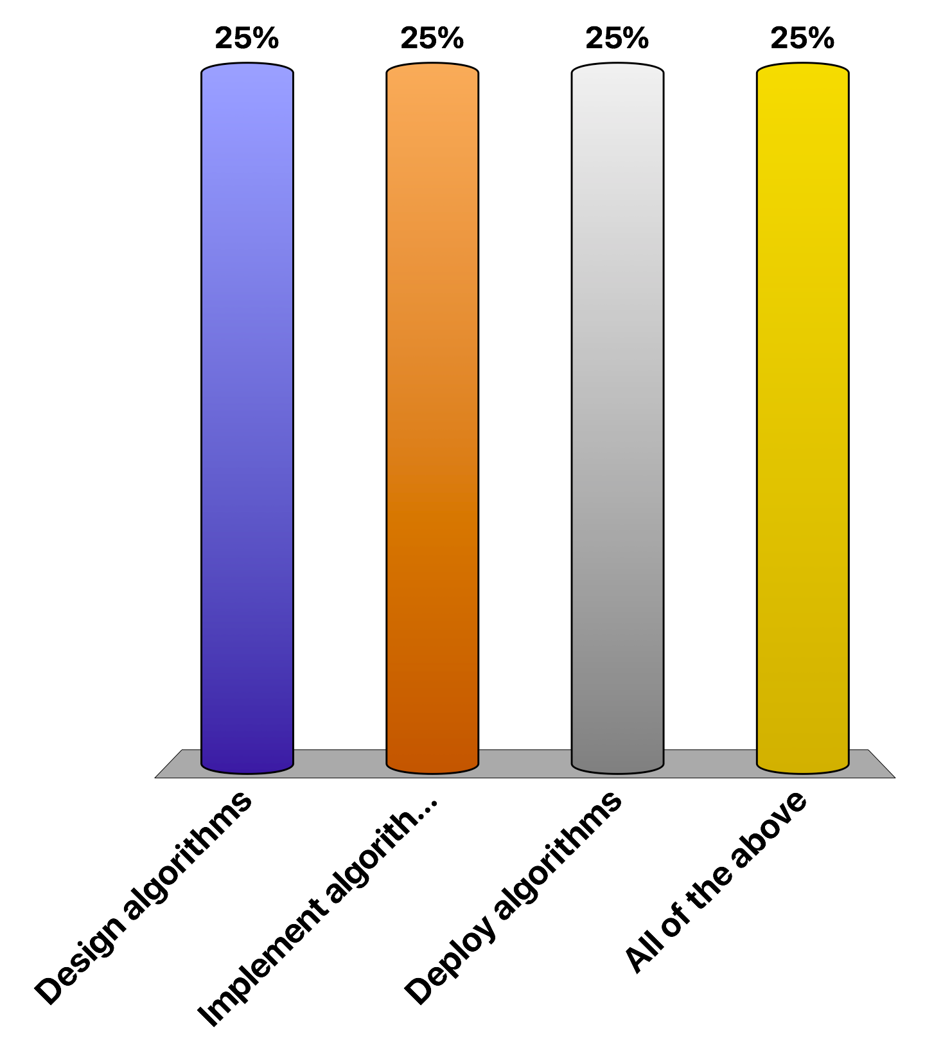
What do we do as Computer Scientists
Design algorithms
Implement algorithms
Deploy algorithms
All of the above
They design, implement and deploy efficient and correct algorithms.

Slide 4
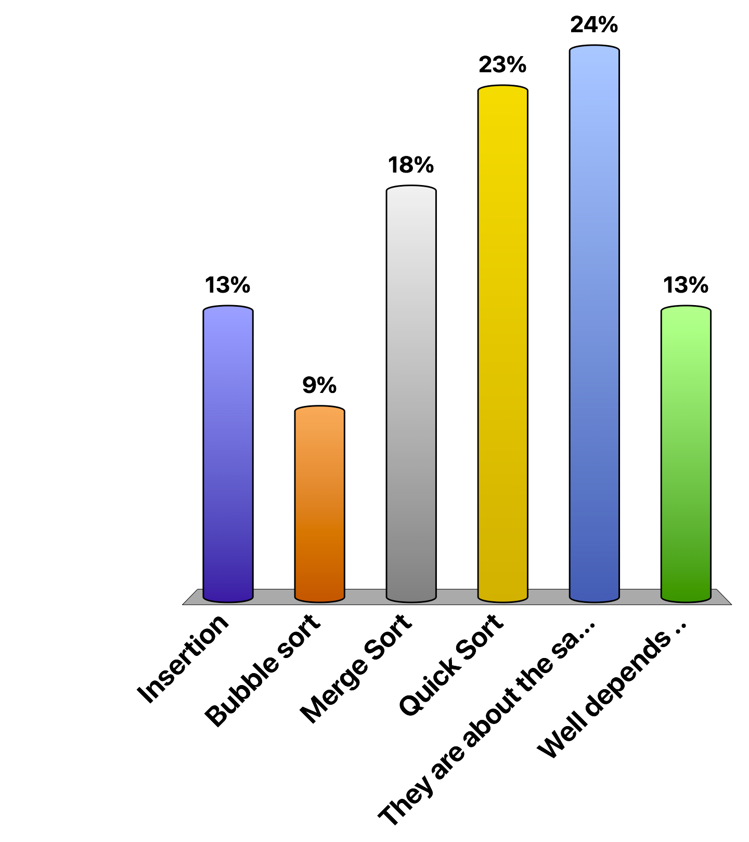
Which one is faster on Random Input?
Insertion
Bubble sort
Merge Sort
Quick Sort
They are about the same
Well depends ..

Slide 5
Moral of the story
Efficiency of a program depends on
The algorithm employed
The input
In computer science we try to compare algorithms on the
Worst case basis?
Best case basis?
Average case basis?
Ans: Typically worst case. Average case is often hard.

Slide 6
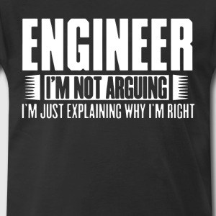

Slide 7
Stable Marriage Problem
There are n men and n women
Each man has a preference list, so does the woman.
These lists have no ties.
No Polygamy
Devise a system by which each of the n men and n women can end up getting married.

Slide 8








Here Comes the Story…
Geeta, Heiki, Irina, Fran
Adam, Bob, Carl, David
Adam
Fran
Irina, Fran, Heiki, Geeta
Carl, David, Bob, Adam
Bob
Geeta
Geeta, Fran, Heiki, Irina
Carl, Bob, David, Adam
Carl
Heiki
Irina, Heiki, Geeta, Fran
Adam, Carl, David, Bob
David
Irina

Slide 9


Search for a Matching
X
Adam
Geeta
David
Heiki
Geeta prefers Carl to Adam!
Unstable Pair
X
Bob
Irina
Carl
Fran
Carl likes Geeta better than Fran!

Slide 10
Gale-Shapley Algorithm – TMA - Men Propose, women accept/reject
Geeta, Heiki, Irina, Fran
Adam, Bob, Carl, David
Adam
Fran
Irina, Fran, Heiki, Geeta
Carl > Adam
This is a stable matching
Carl, David, Bob, Adam
Bob
Geeta
Geeta, Fran, Heiki, Irina
Carl, Bob, David, Adam
Carl
Heiki
Irina, Heiki, Geeta, Fran
David > Bob
David
Irina
Adam, Carl, David, Bob

Slide 11
The Mathematical Truth!
The Traditional Marriage Algorithm always produces a male-optimal, female-pessimal pairing.

Slide 12
Graphs
A
3
E
Adam
1
4
2
B
F
C
G
D
H

Slide 13
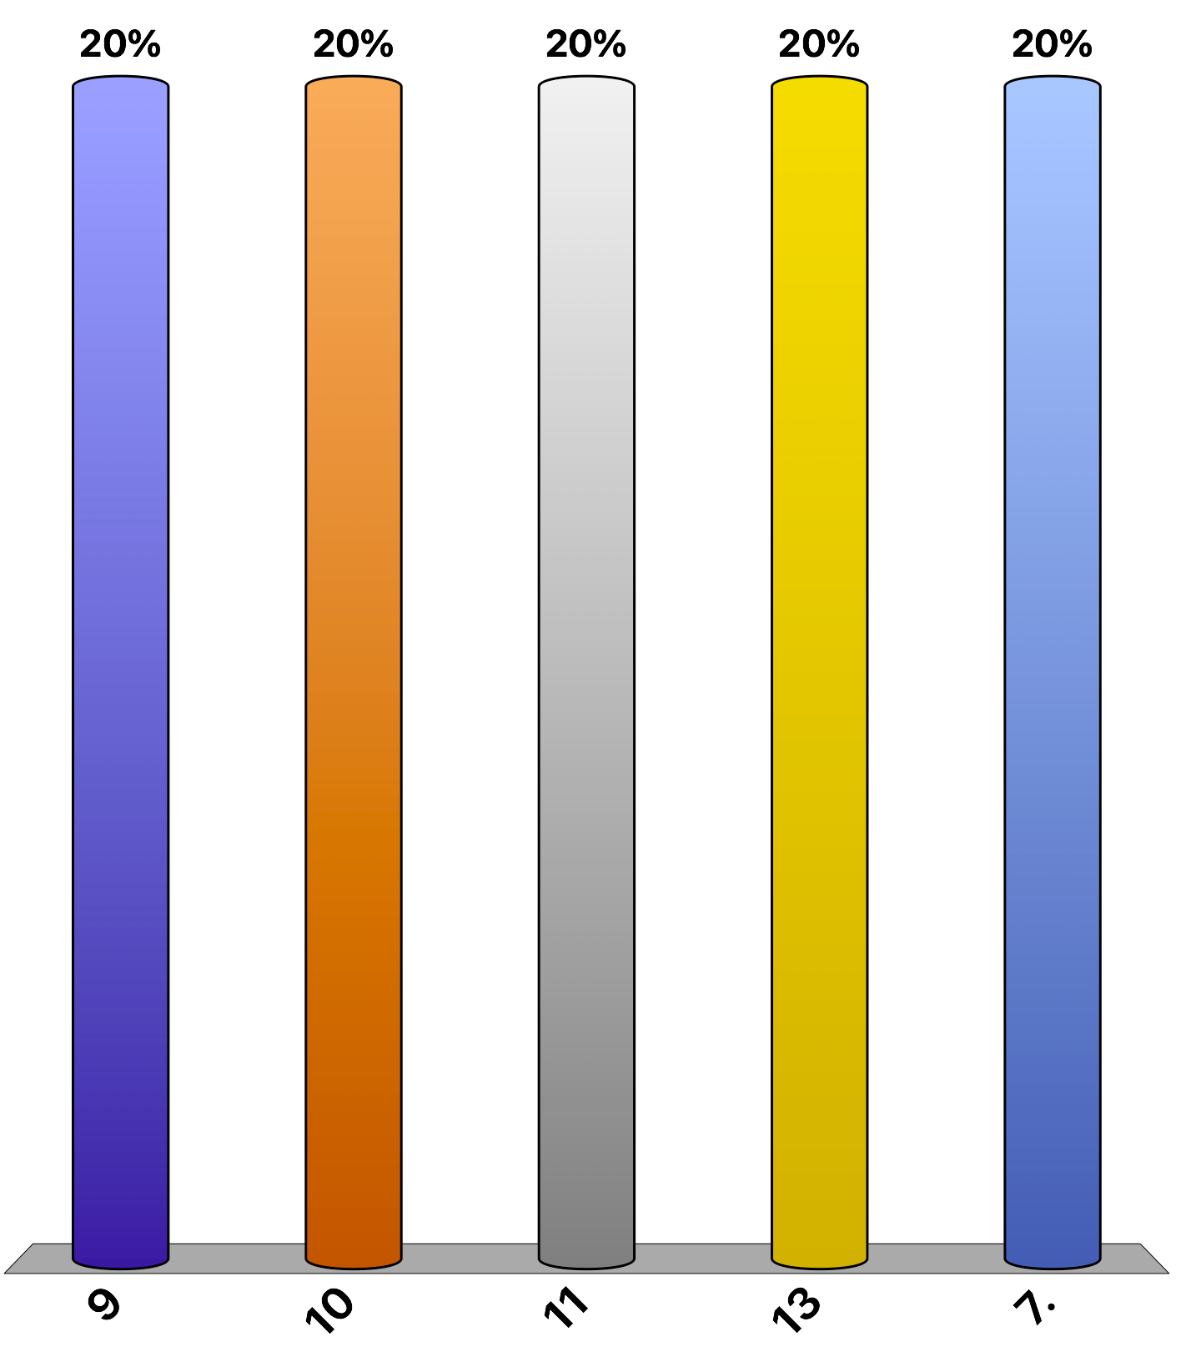
Shortest Path
9
10
11
13
7.

Slide 14
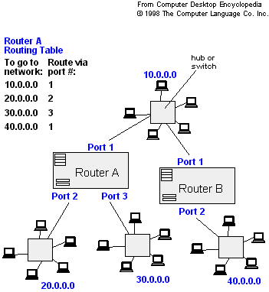
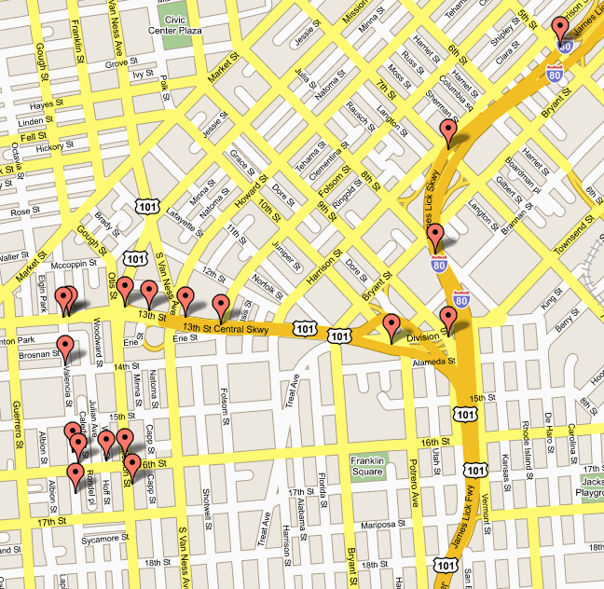
Applications
- Maps (Map Quest, Google Maps)
- Routing Systems

Slide 16
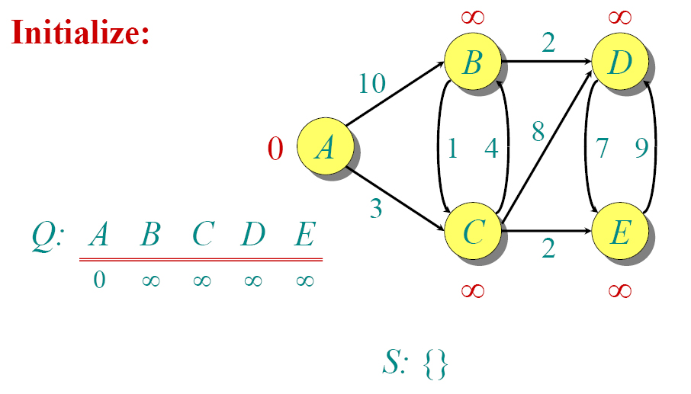
Dijkstra Animated Example

Slide 17
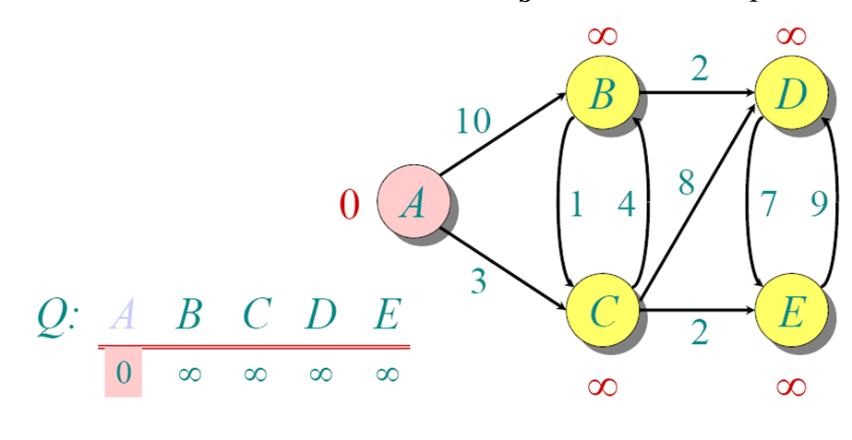
Dijkstra Animated Example

Slide 18
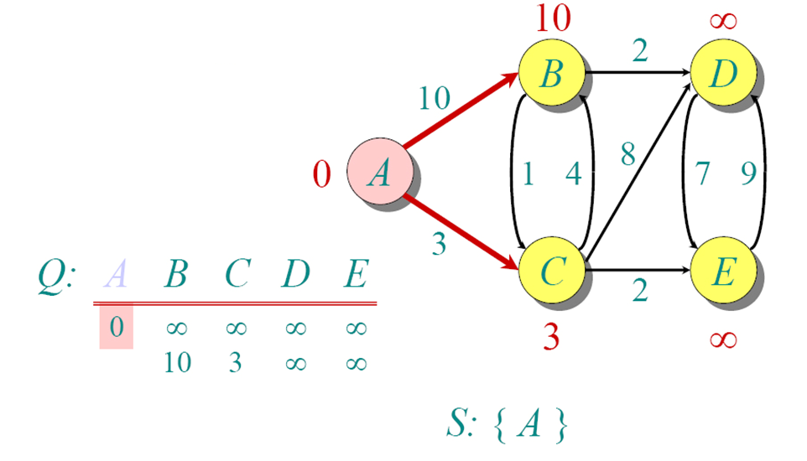
Dijkstra Animated Example

Slide 19
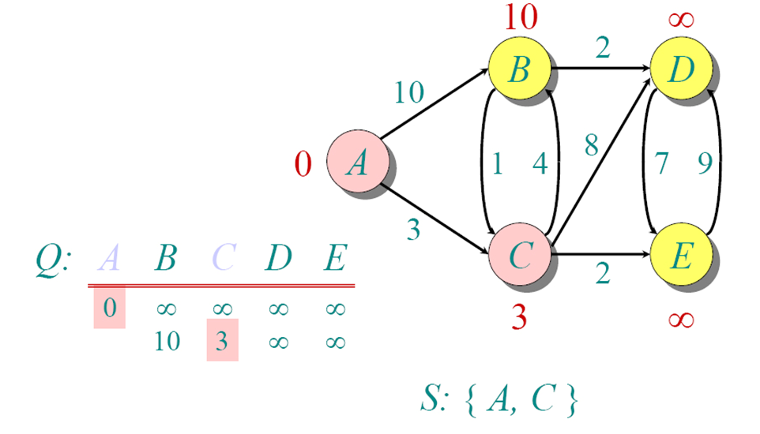
Dijkstra Animated Example

Slide 20
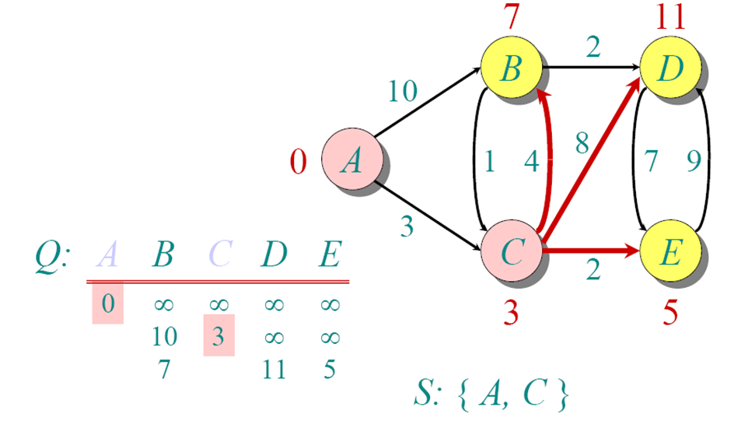
Dijkstra Animated Example

Slide 21
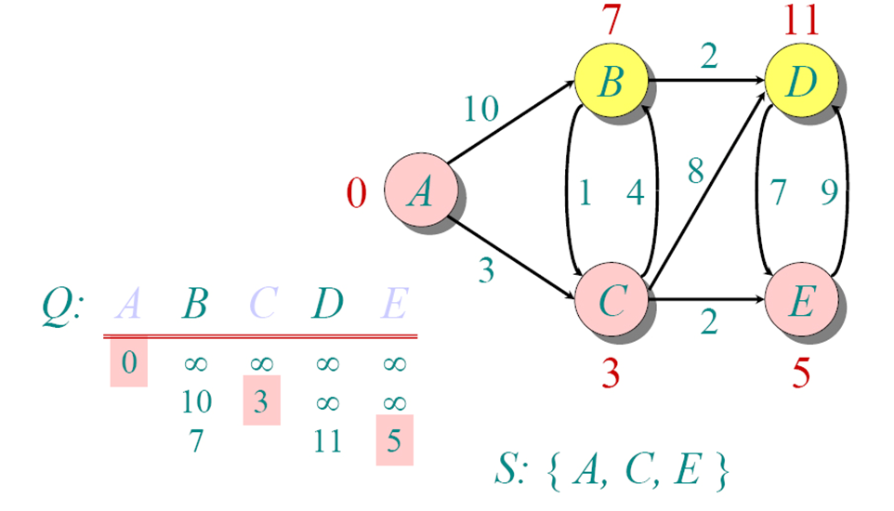
Dijkstra Animated Example

Slide 22
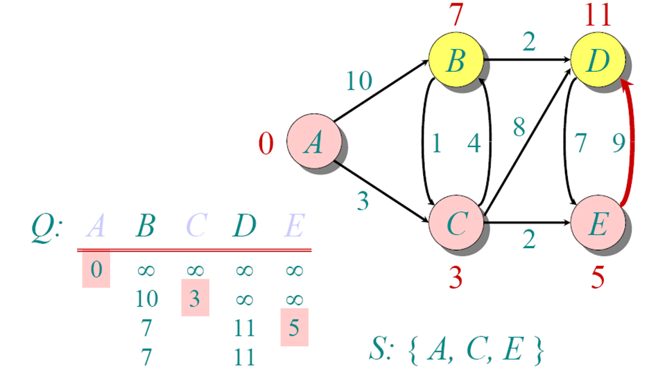
Dijkstra Animated Example

Slide 23
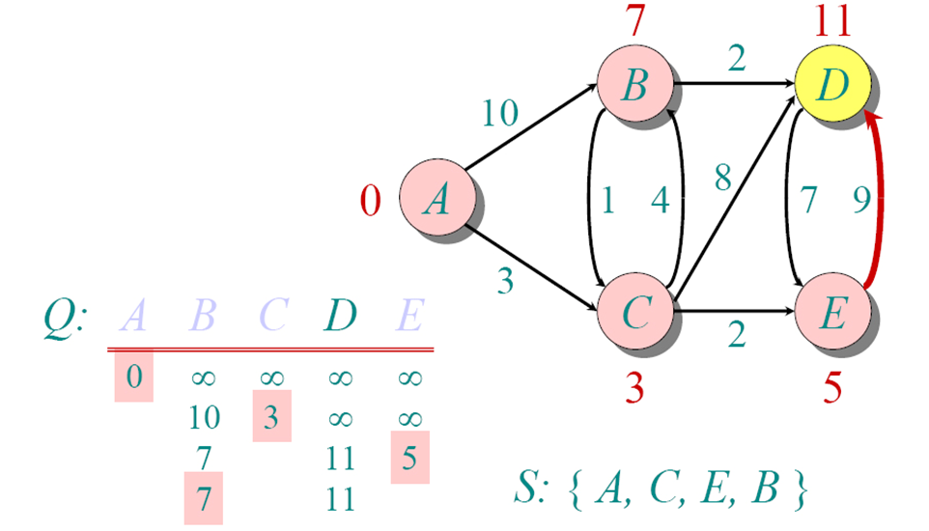
Dijkstra Animated Example

Slide 24
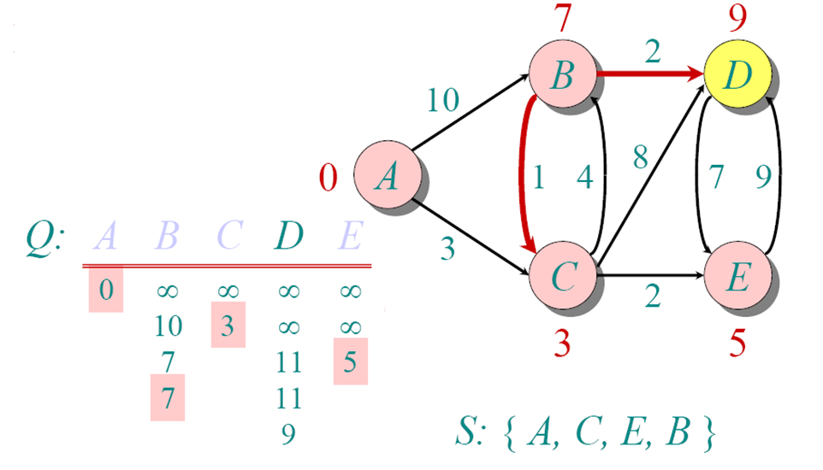
Dijkstra Animated Example

Slide 25
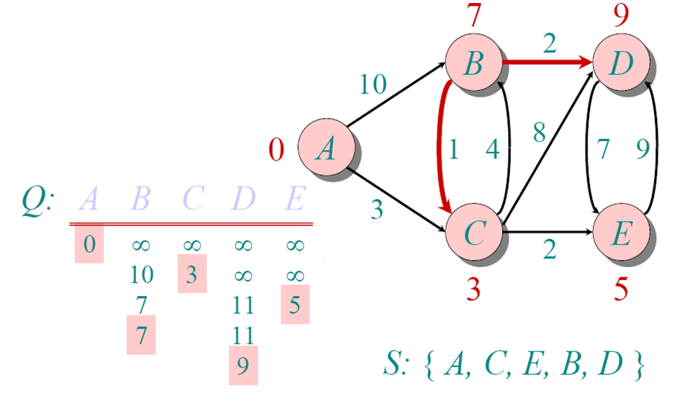
Dijkstra Animated Example

Slide 26
Why would this algorithm always provide the correct answer?
You will learn to prove this in an algorithms course

Slide 27
Networking
Databases
Distributed Systems
Search Engines and
Information Retrieval
Computer Security
Software Engineering
Torsten Suel
CSE Department
NYU Tandon
torsten.suel@nyu.edu
Computer Graphics

Slide 28
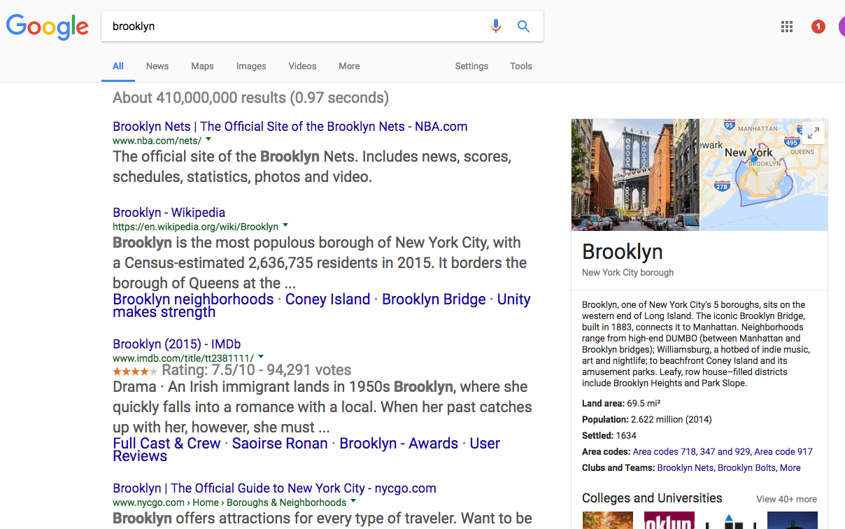
Web Search:
type in some words
get back results (usually 10 at a time)
hopefully good results among these
if not, change your query, try again

Slide 29
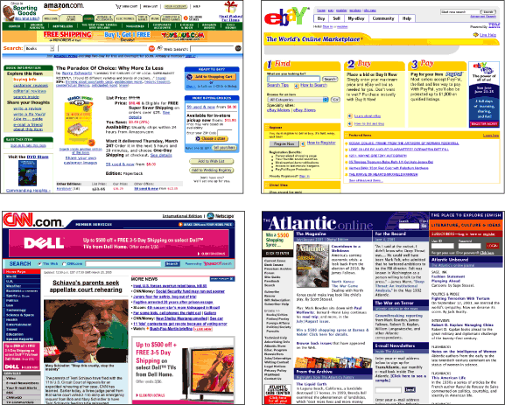
Text View of the Web:
- billions of pages of text
- with html markup
- and flash, javascript, etc
- and images, audio, etc
- and cgi
- and database backends
- but basically, text
- “pages” or “documents”

Slide 30
Graph View of the Web:

Slide 31
Site and Domain Structure:
Web Server
(Host)
Web Server
(Host)
www.cnn.com
www.nyu.edu
Web Server
(Host)
www.irs.gov

Slide 32
Basic Structure of a Search Engine:
analysis/
mining
crawler
index
indexing
disks
query
processing
Search
interface
query: “computer”

Slide 33
Challenges for search engines:
coverage (need to cover large part of the web)
ranking (in the case of broad and narrow queries)
freshness (need to update content)
user load (> 50000 queries/sec - Google)
manipulation (sites want to be listed first)
monetization (how to make money from queries)
need to crawl and store massive data sets
smart information retrieval techniques
frequent recrawling of content
many queries on massive data
naïve techniques will be exploited quickly
placing best ads based on user behavior

Slide 34
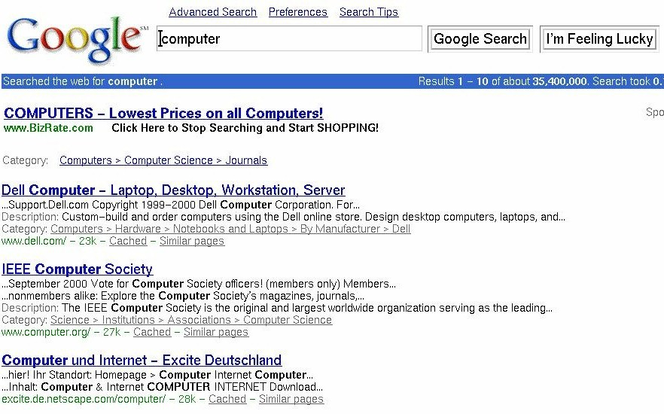
Ranked Querying:
return best pages first
term- vs. link vs. log-based approaches
multiple phases, many features
also add meaningful “snippets”

Slide 35
Which Page is more important?
Ernie’s scrambled egg recipe
Mix four eggs in a bowl with a little salt and pepper, ….
Bert’s scrambled egg recipe
First melt a tablespoon of butter, …
The one with the better recipe
The one with a better design
The one that can be reached faster
The one that had more incoming links
Bert’s recipe is wonderful!
Ernie’s recipe is good.
I really enjoyed Bert’s recipe.
Bert’s recipe is fantastic!

Slide 36
Are all pages equal?
Which page is more important?
The one with better recipe
The one which is pointed to by more pages?
The one that is pointed to by important people
Ernie’s scrambled egg recipe
Mix four eggs in a bowl with a little salt and pepper, ….
Bert’s scrambled egg recipe
First melt a tablespoon of butter, …
Nasir Memon’s home page
I tried Ernie’s recipe once, and it’s not bad at all.
Alice Water’s home page
Bert’s recipe is clearly one of the best.

Slide 37
Ernie’s scrambled egg recipe
Mix four eggs in a bowl with a little salt and pepper, ….
Bert’s scrambled egg recipe
First melt a tablespoon of butter, …
Which Page is more important?
Which page is more important?
The one with better recipe
Ernie’s
Bert’s
They are about the same
Nasir Memon’s home page
I tried Ernie’s recipe once, and it’s not bad at all.
Alice Water’s home page
Bert’s recipe is clearly one of the best.
1
1
1
………..
1
1
1
1
1
100 Pages
1

Slide 38
Ernie’s scrambled egg recipe
Mix four eggs in a bowl with a little salt and pepper, ….
Bert’s scrambled egg recipe
First melt a tablespoon of butter, …
The notion of Authority?
2
100
“links from paged with higher authority should result in a higher ranking than links from lower authority”
Nasir Memon’s home page
I tried Ernie’s recipe once, and it’s not bad at all.
Alice Water’s home page
Bert’s recipe is clearly one of the best.
100
2
1
1
1
………..
1
1
1
1
1
100 Pages
1

Slide 39
What about cycles??
A
B
C
D
E
2
2
4
4
1
1
2
1
1
4

Slide 40
Random Surfer Model
B
C
A
D

Slide 41
Surfer Authority Scores
B
109
16
74
C
58
13
55
46
17
55
32
21
15
101
118
A
126
144
D

Slide 42
Surfer Authority Scores
B
10%
2%
7%
C
5%
2%
4%
4%
2%
4%
4%
2%
2%
10%
13%
A
14%
15%
D

Slide 43
Surfer Authority Scores
Ernie’s scrambled egg recipe
Bert’s scrambled egg recipe
1%
28%
Nasir Memon’s home page
Alice Water’s home page
32%
1%
0.4%
0.4%
0.4%
………..
0.4%
0.4%
0.4%
0.4%
0.4%
100 pages
0.4%

Slide 44
Surfer Authority Scores
A
B
33%
31%
C
D
E
3%
3%
30%

